Slide 1
Prototype Design
TEAM : FLUX
TIME:2024.11

Slide 2
Part 01
Project Progress
Part 02
Interface design progress
OUTLINE
Part 03
Interface content description
Part 04
Implementation Status

Slide 3
Part .01
Project progress

Slide 4

Project Progress
Multiple Interface
Completed designs for login, dashboard, device management, and user information interfaces.
Usability Improvements:
Enhanced user interaction experience by refining interface usability.
Further Implementation Plan
Established plans for future feature expansion and performance optimization.

Slide 5
Part .02
Interface design progress

Slide 6

Interface design progress
Concise
With Figma
User friendly
Interactive
Intuitive
Personalized
Easy handling
Reactive
Coherent
Design Concept
Design Principle
Designed interfaces using Figma, ensuring compatibility with both mobile and web platforms.
Applied design principles such as user-friendliness, interactivity, and responsiveness.

Slide 7
Interface design progress
Mobile Device Compatibility
Implemented responsive design for optimal display across various screen sizes.
Data Visualization
Utilized clear labels, legends, and tooltips to effectively display multiple data points and charts.
Security
Ensured data security with encryption and authentication for safe data transmission and storage.
Map Integration & Device Positioning
Integrated map APIs and custom icons for real-time device location monitoring.
User Feedback
Collected and analyzed user feedback through surveys and reviews to continually improve the interface.
Interface Aesthetics & User Experience
Used a consistent color scheme and intuitive icons for an appealing, user-friendly design.

Slide 8
Part .03
Interface content description

Slide 9
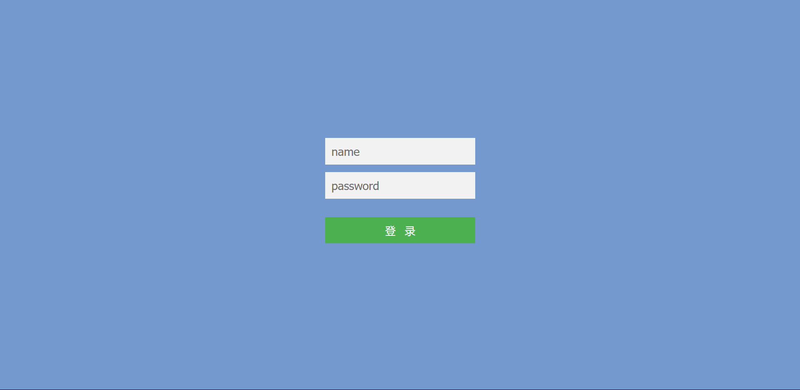
Interface content description
Login Interface:
编辑标题内容
点击文本框即可进行编辑输入相关内容点击文本框即可进行编辑输入相关内容点击文本框即可进行编辑输入相关内容
Designed both login and registration pages to guide users seamlessly into the system.
TITLE HERE

Slide 10
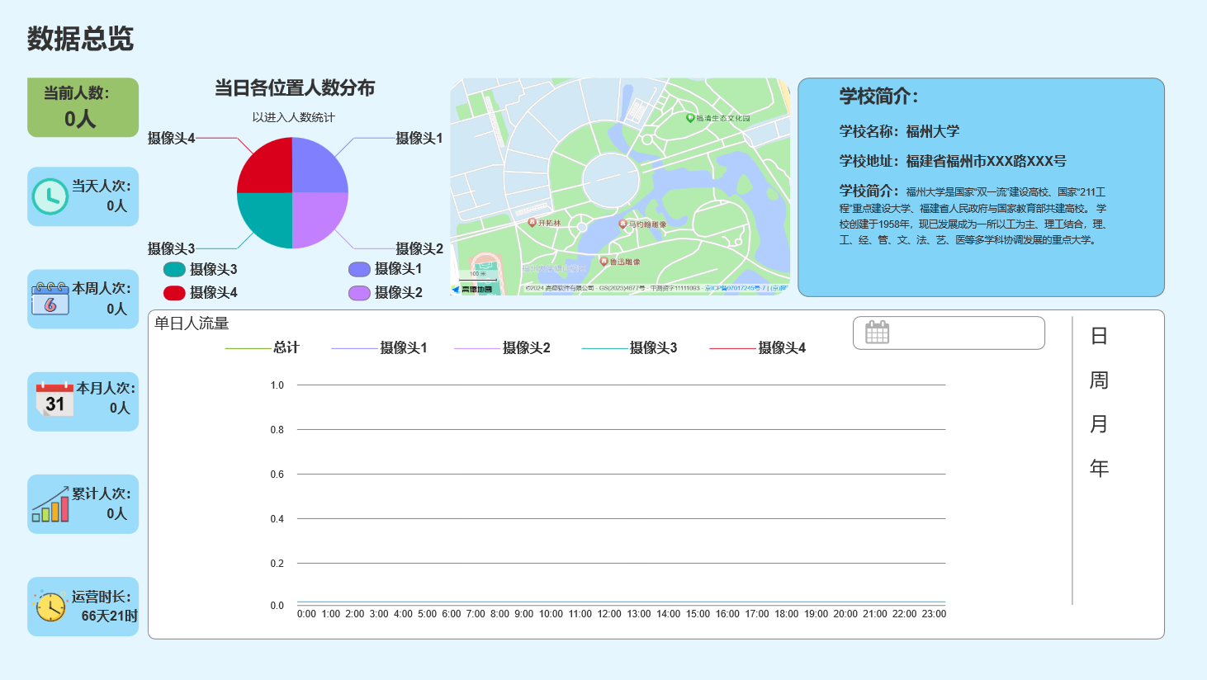
Interface content description
Dashboard Interface:
编辑标题内容
点击文本框即可进行编辑输入相关内容点击文本框即可进行编辑输入相关内容点击文本框即可进行编辑输入相关内容
Displays system statistics (e.g., total traffic for the day, distribution of traffic by location) and displays daily traffic trends in line charts. At the same time, it can also show the recent traffic of different time periods
TITLE HERE

Slide 11
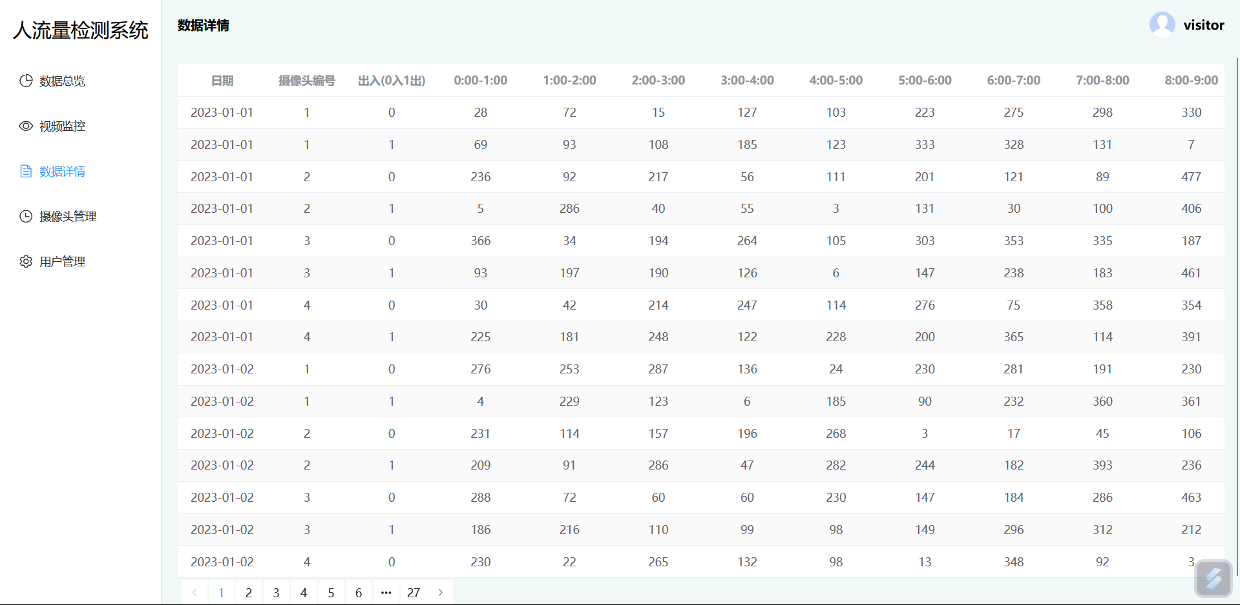
Interface content description
Data detail interface:
编辑标题内容
点击文本框即可进行编辑输入相关内容点击文本框即可进行编辑输入相关内容点击文本框即可进行编辑输入相关内容
Shows the specific traffic of each online camera at various times of the day.
TITLE HERE

Slide 12
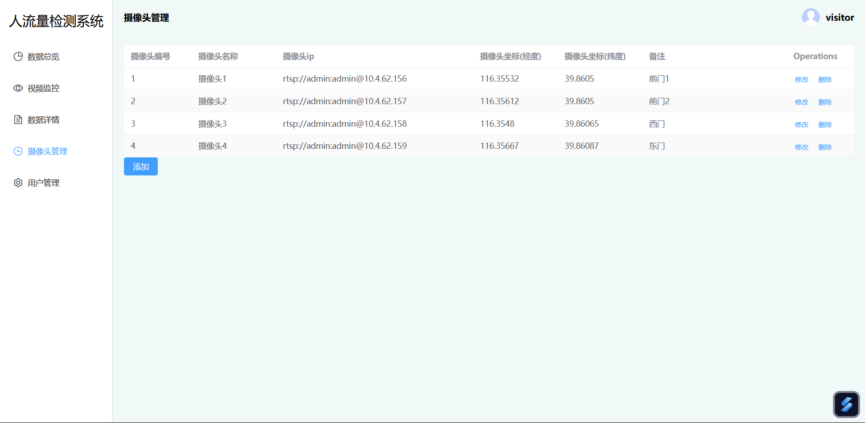
Interface content description
Device Management Interface ---- Device List:
编辑标题内容
点击文本框即可进行编辑输入相关内容点击文本框即可进行编辑输入相关内容点击文本框即可进行编辑输入相关内容
Provides device search, instant data preview (latitude and longitude), and detailed configuration options for users to find and configure devices.
TITLE HERE

Slide 13
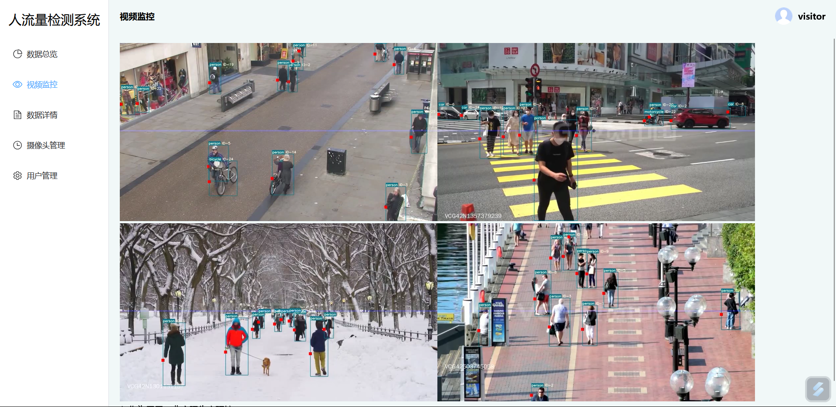
Interface content description
Device monitoring Interface:
编辑标题内容
点击文本框即可进行编辑输入相关内容点击文本框即可进行编辑输入相关内容点击文本框即可进行编辑输入相关内容
Display real-time status of registered devices for easy data management through real-time monitoring of crowd movement within visual range.
TITLE HERE

Slide 14
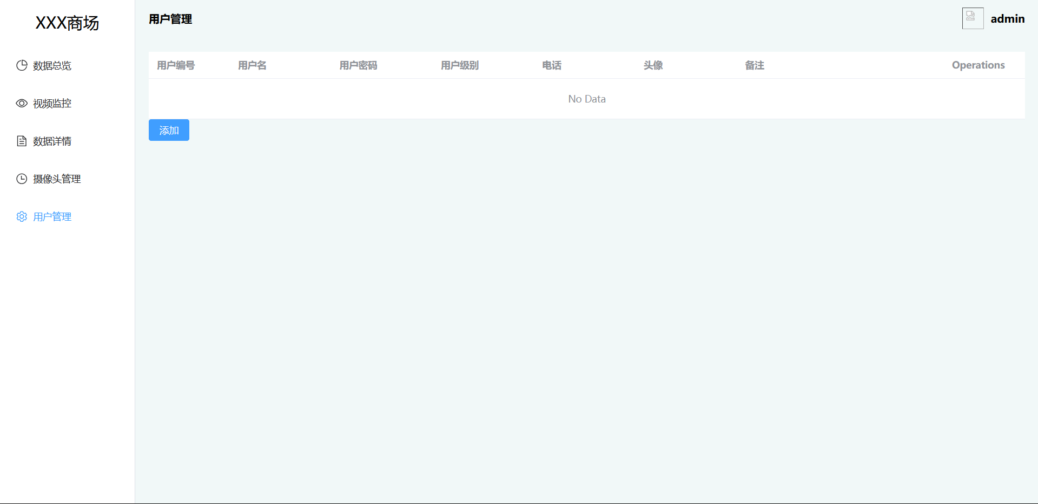
Interface content description
User Information Interface:
编辑标题内容
点击文本框即可进行编辑输入相关内容点击文本框即可进行编辑输入相关内容点击文本框即可进行编辑输入相关内容
Displays personal details with options to edit username, contact info, etc.
TITLE HERE

Slide 15
Part .04
Implementation Status

Slide 16
Implementation Status
832201324 黄涵 | Mobile client interface design, Blog post creation, Progress tracking | 832202128 廖泓霖 | Front-end interface design (Main dashboard interface), Project planning & management
832201103 卢炀 | Front-end interface design (Overall management), Project coordination | 832201319 尚天翼 | Front-end interface design (Device information interface), Product promotion
832202102 叶晗皓 | Front-end interface design (User information interface), Embedded system integration | 832201305 阮子瀚 | AI model development, Data processing pipeline, System integration
832201118 岳文韬 | Front-end interface design (Device management interface), Embedded system development, Back-end integration | 832201321 胡伟俊 | User experience design, User feedback collection, Interface optimization
832202122 俞卓铁 | Front-end interface design (Device map interface), Quality control
832202105 刘思远 | Data visualization design, Performance analysis, Front-end enhancements
832201311 李睿萱 | Front-end interface design (Device addition interface), Front-end development
832201323 郭荣恩 | Security implementation, Authentication systems, Data protection measures
832201108 李睿 | Front-end interface design (Device management interface), Document management, Embedded system development
832201322 钟昊言 | Testing and debugging, Quality assurance, Feedback management

Slide 17
Thanks for your attention
TEAM : FLUX
TIME:2024.11

